Slide 1
Juan Bisquert
Nanostructured Energy Devices: Equilibrium Concepts and Kinetics
CRC Press
Chapter 5
Thermal distribution of electrons, holes and ions in solids
10. Cell potential in the lithium ion battery
11. Insertion of ions: the lattice gas model

Slide 2
Reproduced with permission from Goodenough, J. B.; Kim, Y. "Challenges for rechargeable Li batteries". Chemistry of Materials 2010, 22, 587-603.
Juan Bisquert Nanostructured Energy Devices: Equilibrium Concepts and Kinetics
CRC Press
10. Cell potential in the lithium ion battery
Figure 5.16. Two quadrants of the cubic spinel A[B₂]X₄ showing the occupied tetrahedral sites (8a), occupied octahedral sites (16d), and unoccupied octahedral sites (16c). The Li species of Li_{1-x}[B₂]O₄ occupy 8a tetrahedral sites, and those of Li_{1+x}[B₂]O₄ occupy only unoccupied octahedral sites (16c). The Li species of Li_{x}[Ti₂]S₄ occupy only unoccupied octahedral sites (16c) for all x of 0≤ x ≤ 2.

Slide 3
Reproduced with permission from Goodenough, J. B.; Kim, Y. "Challenges for rechargeable Li batteries". Chemistry of Materials 2010, 22, 587-603.
Juan Bisquert Nanostructured Energy Devices: Equilibrium Concepts and Kinetics
CRC Press
Figure 5.17. Polyhedral representation of the structure of LiFePO₄ viewed (a) along the b-axis and (b) along the c-axis.

Slide 4
Juan Bisquert Nanostructured Energy Devices: Equilibrium Concepts and Kinetics
CRC Press
Figure 5.18. Energy diagram of a LIB composed of lithium metal anode and metal oxide cathode as shown in the top of the scheme. is the Fermi level of electrons at each electrode. © Juan Bisquert

Slide 5
Reproduced with permission from Goodenough, J. B.; Kim, Y. "Challenges for rechargeable Li batteries". Chemistry of Materials 2010, 22, 587-603.
Juan Bisquert Nanostructured Energy Devices: Equilibrium Concepts and Kinetics
CRC Press
Figure 5.19. Electron energy diagram vs density of states for several anode and cathode materials for which discharge curves are shown in Fig. 3.24(a), showing the positions of the Fermi energy with respect to Li⁺/Li, in an itinerant electron band for Li_{x}C₆, the Ti⁴⁺/Ti³⁺ redox couple for Li_{x}TiS₂ and Li_{x}[Ti₂]S₄, the Co⁴⁺/Co³⁺ redox couple for Li_{x}CoO₂, and the Co³⁺/Co²⁺ redox couple for Li_{x}CoPO₄.

Slide 6
Reproduced with permission from Tonti, D.; Zanoni, R.; “Electronic and chemical properties: X-Ray Photoelectron Spectroscopy” in J. Garche, Ch. Dyer, P. Moseley, Z. Ogumi, D. Rand and B. Scrosati, editors. Encyclopedia of Electrochemical Power Sources; Elsevier: Amsterdam, 2009; pp 673-695.
Juan Bisquert Nanostructured Energy Devices: Equilibrium Concepts and Kinetics
CRC Press
Figure 5.20. Soft x-ray photoelectron spectroscopy (SXPS) spectra from (left) Li 1s, Se 3d, and (middle) the valence band (VB) of TiSe₂ (0001) intercalated at room temperature with Li by sublimation in ultrahigh vacuum for the reported times. The adsorbed Li is readily intercalated into the substrate without interface decomposition, as shown by the sharp, single component of Li 1 s peak and its binding energy (BE) value. The VB spectra are dominated by the occupied Se 4p band, which remains mostly unchanged in shape, showing only a small shift to larger BEs. The evident increased emission at the Fermi lelvel (BE = 0 eV) indicates filling of previously empty Ti 3d states, due to charge transfer from Li, as sketched in the scheme of energy vs. density of states (right).

Slide 7
Reproduced with permission from Obrovac, M. N.; Gao, Y.; Dahn, J. R. "Explanation for the 4.8-V plateau in Li_{y}Cr_{x}Mn_{2-x}O₄ ". Physical Review B 1998, 57, 5728-5733.
Juan Bisquert Nanostructured Energy Devices: Equilibrium Concepts and Kinetics
CRC Press
Figure 5.21. Discharge curves of Li_{y}Cr_{x}Mn_{2-x}O₄ (0.17 0.83). The step corresponds to a sudden change of the chemical potential of electrons, that occurs when the number of Li⁺ removed from the lattice is (1-x), that corresponds to the oxidation of all the Mn³⁺ ions to Mn⁴⁺ .

Slide 8
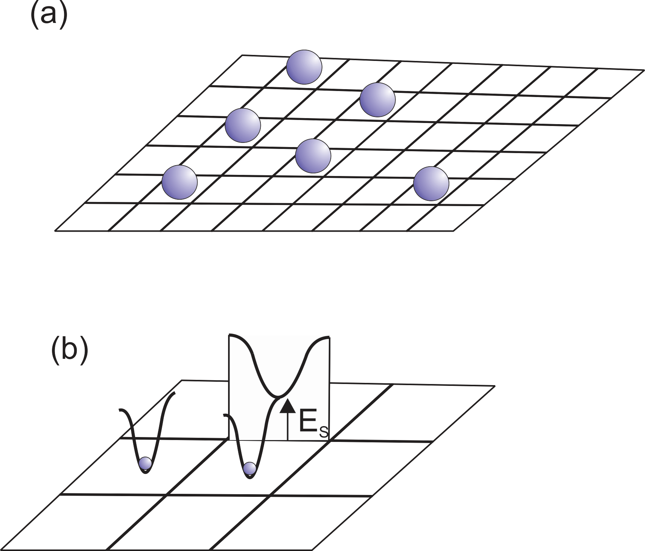
Reproduced with permission from van der Ven, A.; Bhattacharya, J.; Belak, A. A. "Understanding Li diffusion in Li-intercalation compounds". Accounts of Chemical Research 2013, 46, 1216–1225.
Juan Bisquert Nanostructured Energy Devices: Equilibrium Concepts and Kinetics
CRC Press
11. Insertion of ions: the lattice gas model
Figure 5.22. (a) Ions in equilibrium sites in a square lattice. (b) Detail of energetic landscape for ion hopping to a neighbor site, showing the minimum of free energy at two lattice sites, and the saddle point for hopping to a neighbor site with activation energy . (c) and (d). Li migration barriers for hops between neighboring octahedral sites in layered and spinel LiTiS2 are very sensitive to the occupancy of sites adjacent to the intermediate tetrahedral site of the hop. The barrier for hops into isolated vacancies is significantly larger than for divacancy hops and triple vacancy hops.

Slide 9
Juan Bisquert Nanostructured Energy Devices: Equilibrium Concepts and Kinetics
CRC Press
Figure 5.23. Plots of voltage-composition curve (a) and equilibrium chemical capacitance (b) versus voltage of the cathode for the lattice gas model with interaction (mean field), using different values of the interaction parameter, g , as indicated. © Juan Bisquert

Slide 10
Reproduced with permission from Klingler, M.; Chu, W. F.; Weppner, W. "Coulometric titration of substituted Li_{x}La_{(2−x)/3}TiO₃". Ionics 1997, 3, 289-291.
Juan Bisquert Nanostructured Energy Devices: Equilibrium Concepts and Kinetics
CRC Press
Figure 5.24. Discharge curves of Li_{x+d}La_{(2-x)/3}TiO₃ compared to the fitting to lattice gas model theoretical expression of voltage, including a term for the chemical potential of electrons.

Slide 11
Juan Bisquert Nanostructured Energy Devices: Equilibrium Concepts and Kinetics
CRC Press
Figure 5.23. Plots of voltage-composition curve (a) and equilibrium chemical capacitance (b) versus voltage of the cathode for the lattice gas model with interaction (mean field), using different values of the interaction parameter, g , as indicated. © Juan Bisquert

Slide 12
© Juan Bisquert
Juan Bisquert Nanostructured Energy Devices: Equilibrium Concepts and Kinetics
CRC Press
Figure 5.25. (a) Plot of voltage-composition curve for a two level system with N₁ sites of energy eV and 2N₁ sites of energy = 1.3 eV. (b) Equilibrium chemical capacitance .

Slide 13
Reproduced with permission from Ohzuku, T.; Kitagawa, M.; Hirai, T. "Electrochemistry of manganese dioxide in lithium nonaqueous cell". Journal of The Electrochemical Society 1990, 137, 769-775.
Juan Bisquert Nanostructured Energy Devices: Equilibrium Concepts and Kinetics
CRC Press
Figure 5.26. Equilibrium discharge curve for Li_{x}Mn₂O₄. The discharge of the tetrahedral sites produces a capacity of 120 mA h/g, as shown in Fig. 3.24(c).

Slide 14
Reproduced with permission from Kim, S. W.; Pyun, S. I. "Thermodynamic and kinetic approaches to lithium intercalation into a Li_{1-x}Mn₂O₄ electrode using Monte Carlo simulation". Electrochimica Acta 2001, 46, 987-997.
Juan Bisquert Nanostructured Energy Devices: Equilibrium Concepts and Kinetics
CRC Press
Figure 5.27. Top: Electrode potential versus lithium content curve and the plots of the occupation of two separate sublattices obtained theoretically from the Monte Carlo simulation. Bottom: The theoretical phase diagram representing the order to disorder transition in the LiMn2O4 electrode. The dotted line is the isothermal line at T = 298 K. and indicate the disorder to order and the order to disorder transition points respectively. The disordered phase is stable over the entire range of lithium content above the critical temperature T_{c} .

Slide 15
Reproduced with permission from Kim, S. W.; Pyun, S. I. "Thermodynamic and kinetic approaches to lithium intercalation into a Li_{1-x}Mn₂O₄ electrode using Monte Carlo simulation". Electrochimica Acta 2001, 46, 987-997.
Juan Bisquert Nanostructured Energy Devices: Equilibrium Concepts and Kinetics
CRC Press
Figure 5.28. Equilibrium configuration of the cubic lattice obtained from the Monte Carlo simulation at (a) lithium content = 0.2, (b) 0.5 and (c) 0.8. The closed square and the cross-centered square symbols represent lithium ions at the sites of sub-lattices 1 and 2 respectively.

